Slide 1

Estimating input parameters for decision modeling
Petros Pechlivanoglou
petros.pechlivanolgou@sickkids.ca

Slide 2
Elicitation Methods
Synthetic population
Non parametric methods
Regression modeling
Transition probabilities/ event times
Individual level data
Healthy
Sick
Survival analysis
Aggregate level data
Costs
Meta Analysis
Qualitative / Expert opnions
Dead
Prediction modeling
Utilities

Slide 3
Synthetic population
Non parametric methods
Individual level data
Regression modeling
Aggregate level data
Prediction modeling
Parametric statistics

Slide 4
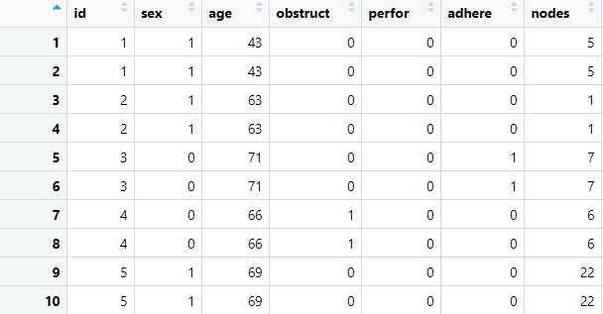
Synthetic population
Individual level data

Slide 5
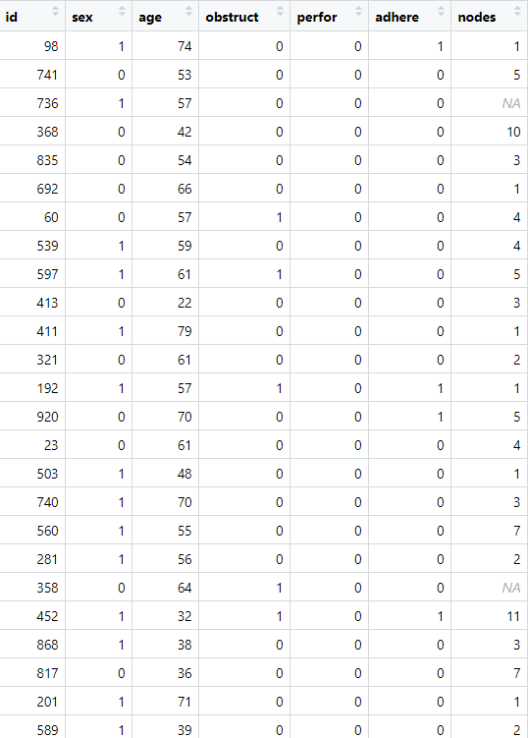
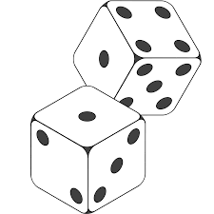
Synthetic population
Non parametric methods
Individual level data
Bootstrap with replacement!

Slide 6
Synthetic population
Individual level data
Fit chained
regression equations
Regression modeling
Prediction modeling
Predict using chained regression equations

Slide 7
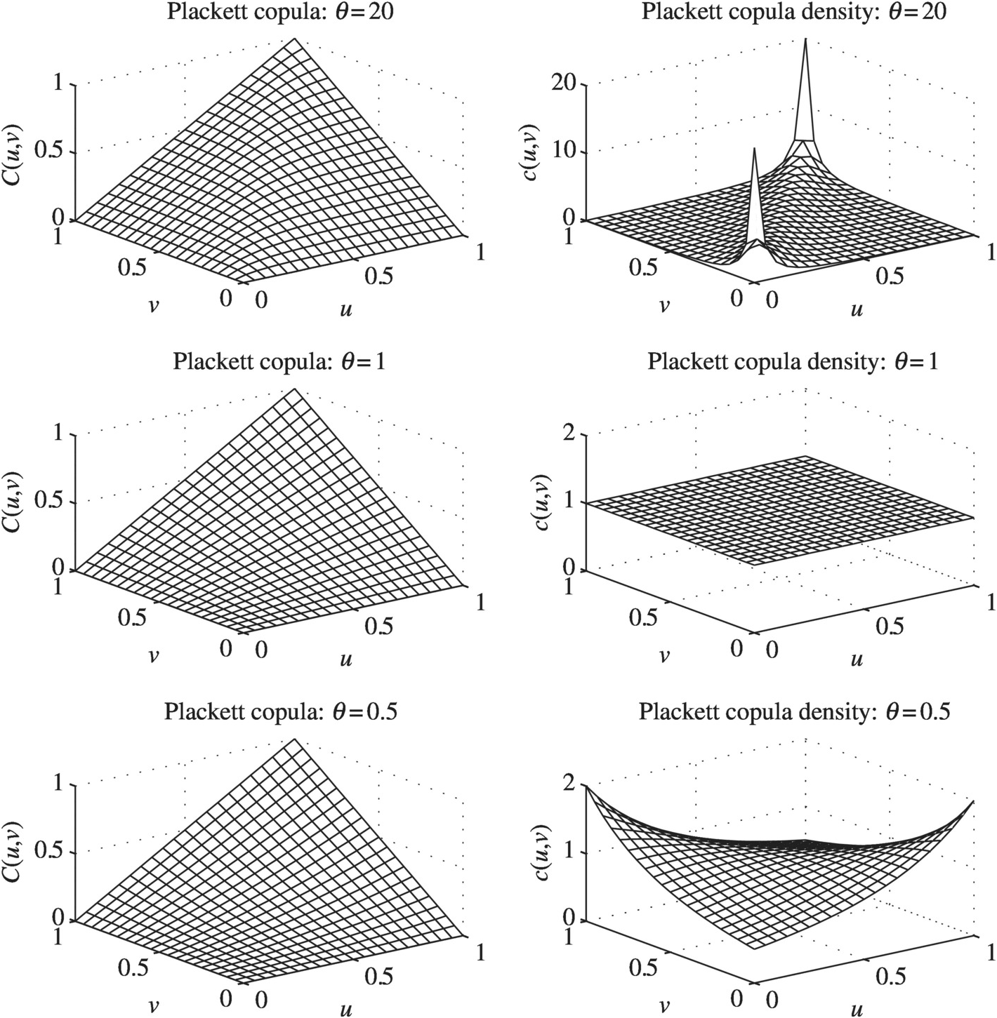
Synthetic population
Aggregate level data
Parametric statistics
https://www.cambridge.org/core/books/abs/copulas-and-their-applications-in-water-resources-engineering/plackett-copula/2D407DAB691623AB52CF74044B42C61F

Slide 8
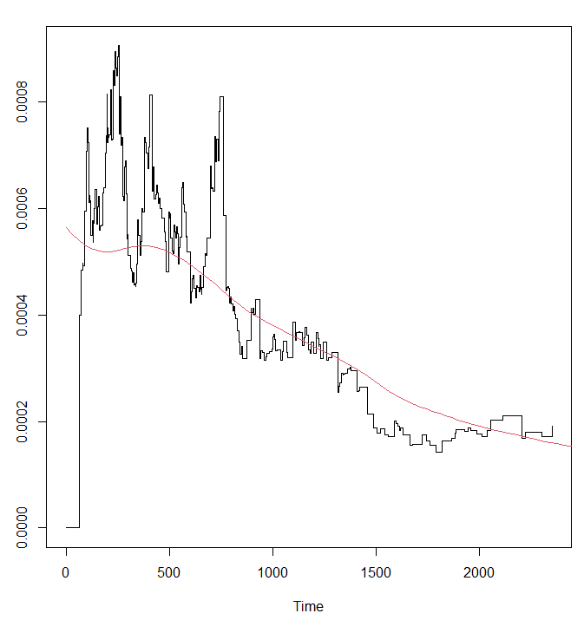
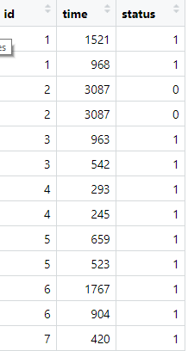
Transition probabilities/ event times
Non parametric methods
Individual level data
Kaplan Meier estimate
of transition probabilities

Slide 9
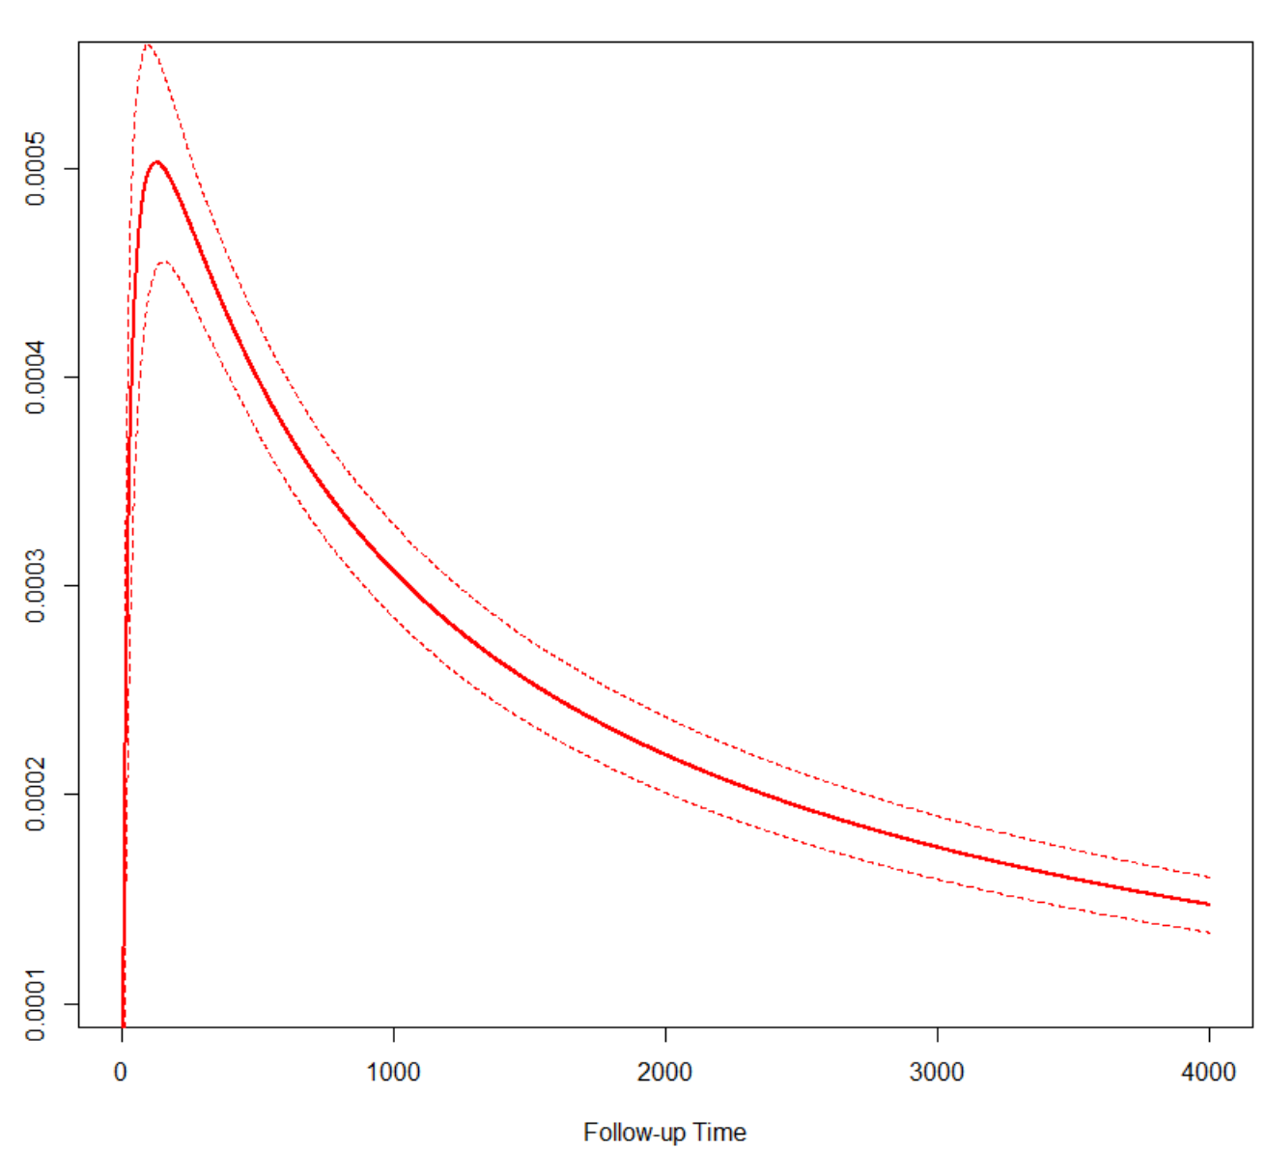
Transition probabilities/ event times
Parametric methods
Individual level data
Lognormal distribution
Transition probabilities
other distributions: gamma, Weibull ,exponential etc)

Slide 10
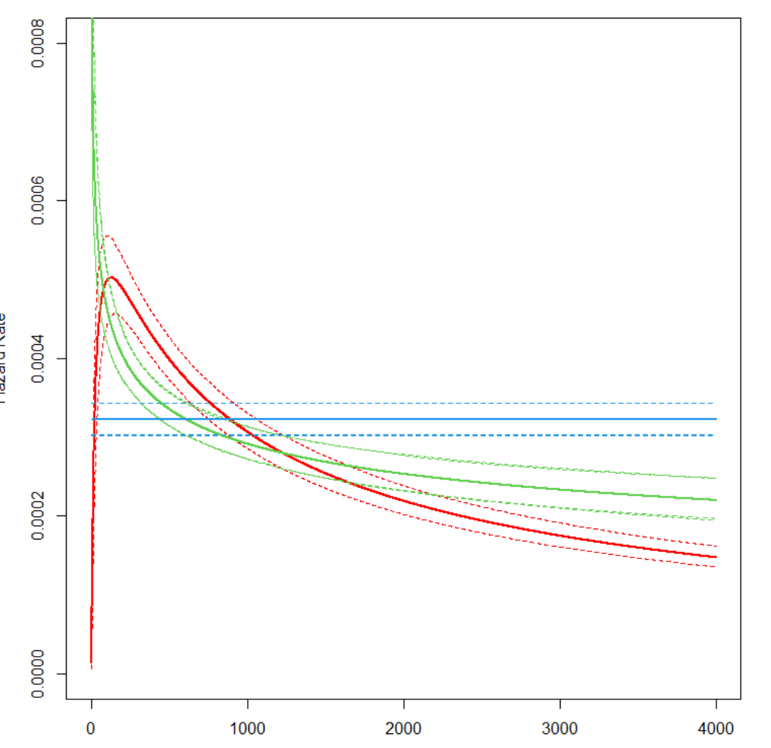
Transition probabilities/ event times
Parametric methods
Individual level data
Exponential
Lognormal
Weibull

Slide 11
Transition probabilities/ event times
Parametric methods
Individual level data
Healthy
Sick
Parametric Multistate modeling
Two ways:
Fit a multivariate model
Fit separate models per transition
Dead

Slide 12
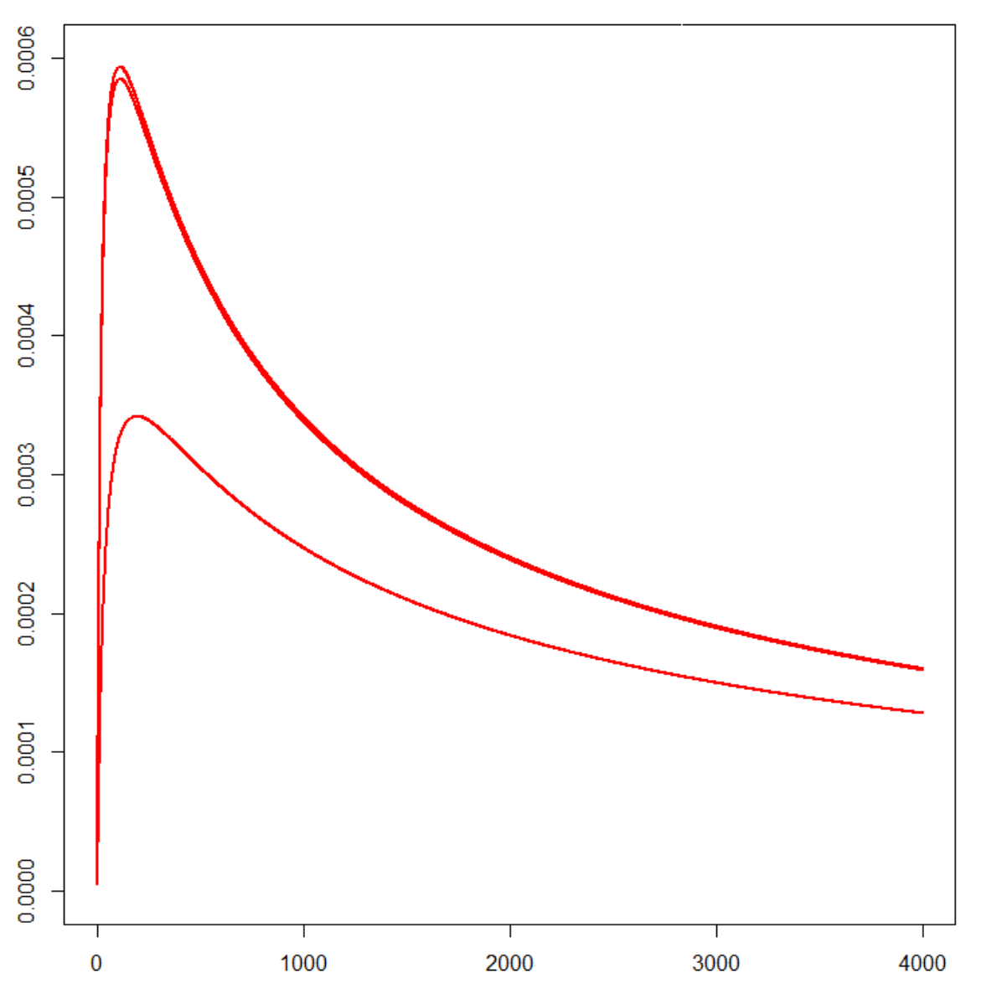
Transition probabilities/ event times
Parametric methods
Individual level data
treatment–specific (or)
Covariate-specific
Transition probabilities
Proportional Hazard assumption
(how likely to hold after end of follow up?)

Slide 13
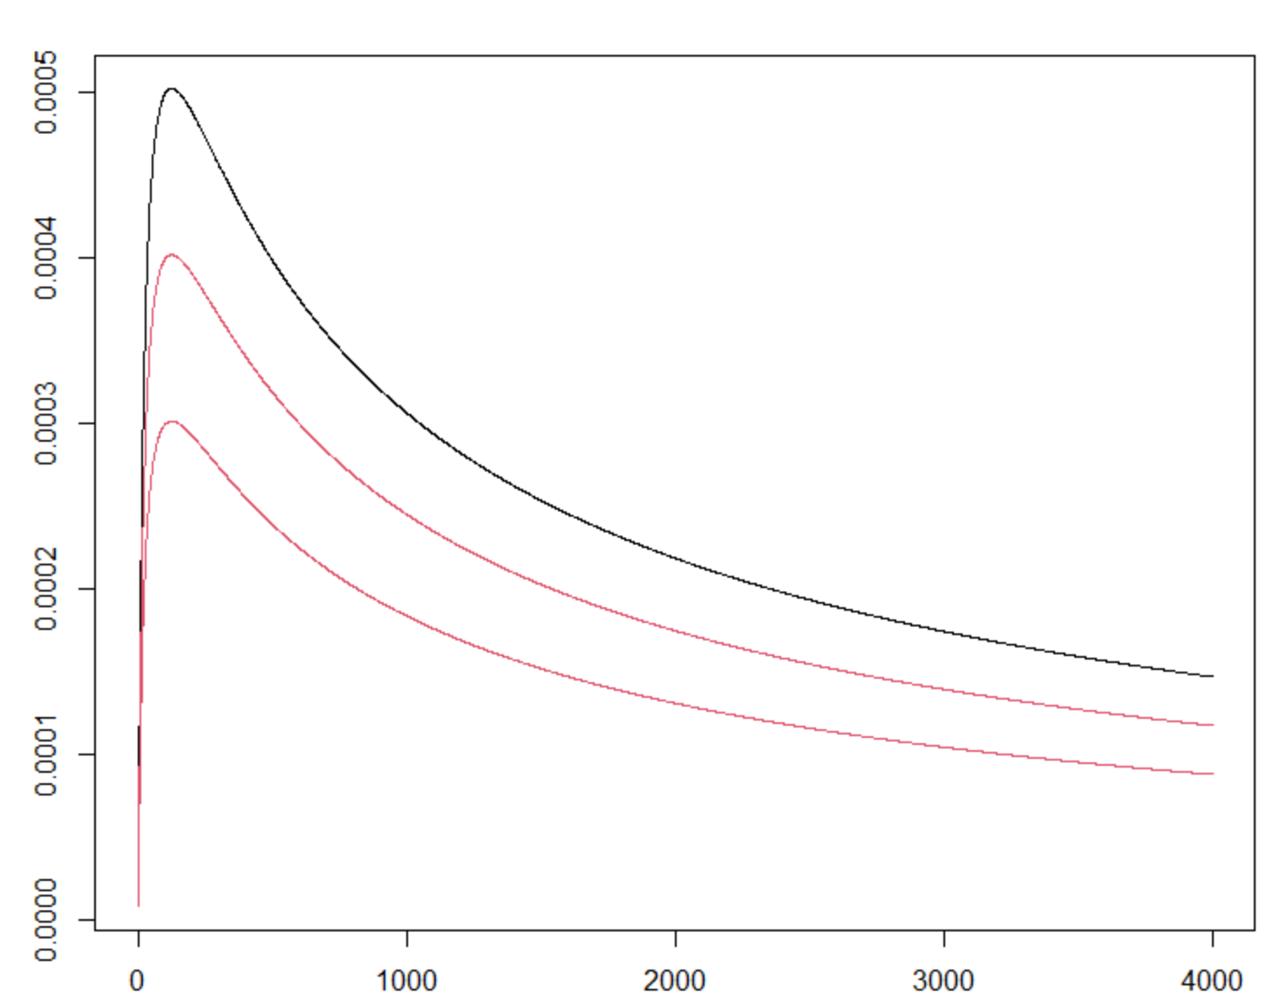
Transition probabilities/ event times
Parametric distribution
Transition probabilities
Baseline treatment
Parametric methods
Individual level data
Aggregate level data
Meta analysis on
Relative effectiveness
(how likely prop hazard
To hold on an MA?)
Alternative NMA with fractional polynomials

Slide 14
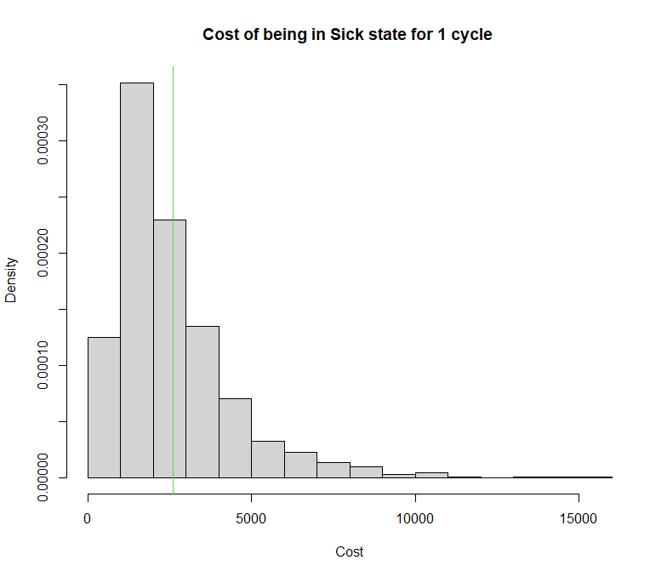
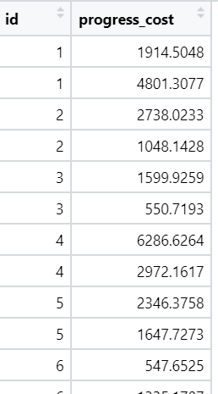
Utilities
Non parametric methods
Costs
Regression modeling
Individual level data
Sample average of
Cost per unit of time
Censoring can be a problem!

Slide 15
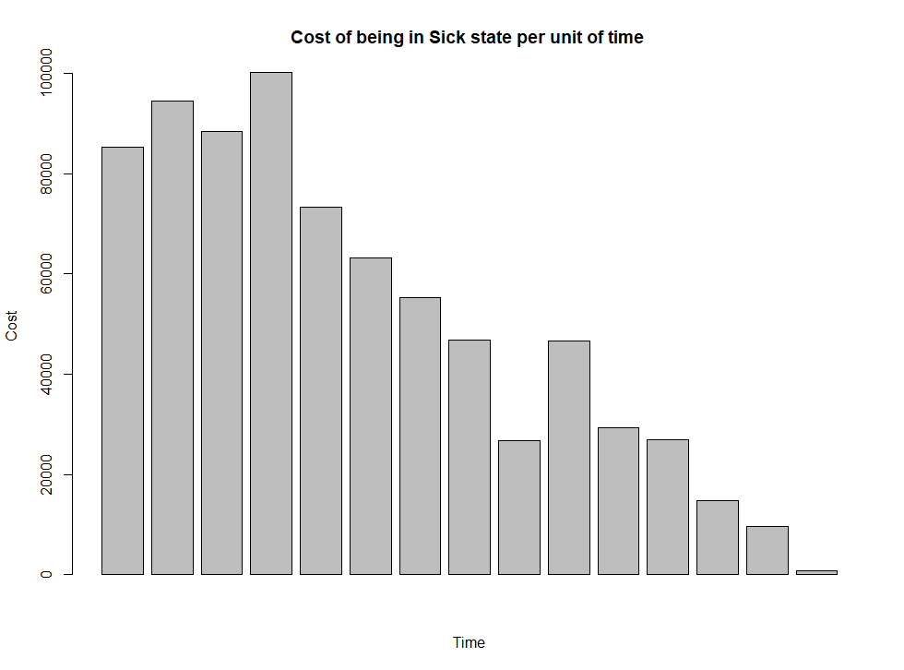
Utilities
Non parametric methods
Costs
Regression modeling
Individual level data
Generalized linear model
with cycle variable to capture temporal effects
Time effect can be highly skewed!!

Slide 16
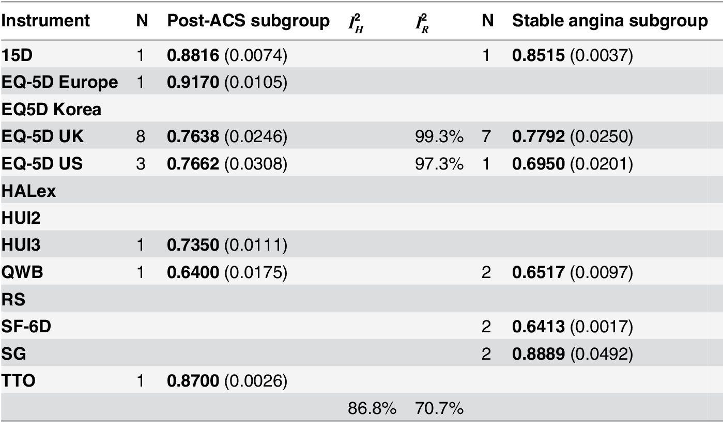

Utilities
Parametric methods
Multivariate meta analysis
Aggregate level data
Healthy
Post ACS
Dead
Stable Angina

